Slide 1
Voltage
Regulators
11th grade
Ensuring stable and reliable power for electronic systems

Slide 2
Introduction
Voltage regulators maintain a constant output voltage despite input or load variations.
They are essential for protecting components, ensuring performance, and enabling reliable operation across power supplies, embedded systems, and portable devices.
Fonts | To view this template correctly in PowerPoint, download and install the fonts we used
Used and alternative resources | An assortment of graphic resources that are suitable for use in this presentation
Thanks slide | You must keep it so that proper credits for our design are given
Colors | All the colors used in this presentation
Infographic resources | These can be used in the template, and their size and color can be edited
Customizable icons | They are sorted by theme so you can use them in all kinds of presentations

Slide 3
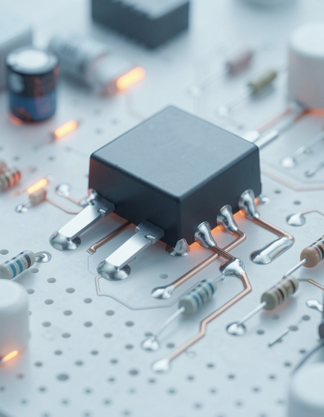
01
Regulator Fundamentals

Slide 4
Definition & Importance
A voltage regulator is a device that provides a stable output voltage.
Key roles: protect sensitive components, prevent malfunction from voltage swings, and enable predictable circuit behavior.
Stable supply improves reliability and extends component lifespan.

Slide 5
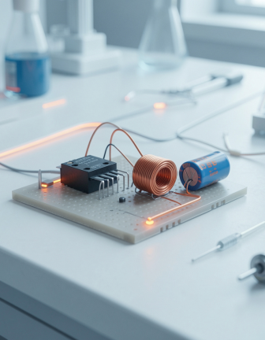
Working Principles
Regulators control output via input sensing and feedback loops.
Linear types adjust pass element; switching types use energy storage and switching to achieve higher efficiency.
Feedback monitors output and corrects deviations to maintain set voltage.

Slide 6
Types Overview
Linear regulators provide low-noise, simple regulation (series and shunt variants).
Switching regulators include buck, boost, and buck‑boost topologies offering higher efficiency at the cost of complexity.
Adjustable regulators allow settable output for flexible designs.
Fonts | To view this template correctly in PowerPoint, download and install the fonts we used
Used and alternative resources | An assortment of graphic resources that are suitable for use in this presentation
Thanks slide | You must keep it so that proper credits for our design are given
Colors | All the colors used in this presentation
Infographic resources | These can be used in the template, and their size and color can be edited
Customizable icons | They are sorted by theme so you can use them in all kinds of presentations

Slide 7
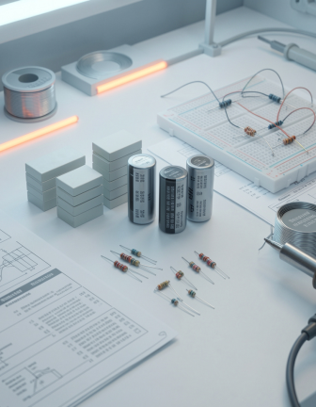
02
Applications & Design

Slide 8
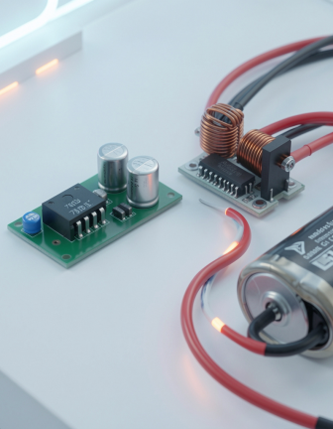
Practical Examples
Example: 7805 linear IC powering logic from 9V with minimal components and simple filtering.
Example: Buck converter for battery-powered devices to maximize battery life while handling variable input.

Slide 9
Advantages & Tradeoffs
Linear: simple, low noise, but dissipates heat and is less efficient.
Switching: high efficiency and small thermal footprint, yet requires inductors, filtering, and EMI control.

Slide 10
Modern Relevance
Critical in renewable energy inverters, IoT nodes, and portable electronics for reliable power management.
Design choices balance efficiency, size, cost, and EMI to meet contemporary device requirements.

Slide 11
Conclusions
Stable voltage regulation is essential for reliable electronics operation and component protection.
Choose topology by prioritizing efficiency, thermal behavior, and system complexity to meet design goals.

Slide 12
Thanks!
Do you have any questions?
youremail@freepik.com
+91 620 421 88
yourcompany.com
Please keep this slide for attribution

